Slide 1
ECE 4233/ECE4281
Working with Families from Diverse Backgrounds
Leadership role of Teachers
發揮教師的領導力
Speaker 講者：Chong Yiu Kwong, Solicitor 莊耀洸律師 Senior Lecturer, EdUHK EPL Dept.
香港教育大學 教育政策與領導學系高級講師
L2 Sem1 2025-26
Special thanks to Dr Lee Tai Hoi, who prepared the draft of this lecture materials.
特別鳴謝李泰開博士擬備此講義

Slide 2


Different perspectives in Leadership
對領導力的不同觀點
行為特質 (behaviour)
培養領導的環境 (environment)
個人魅力 (charisma)
管理技巧 (management skills)
權力 (power and authority)
與追隨者的關係 (relationship with the subordinates)
Notes:
When talking about leadership, there are different perspectives in theories. Some emphasize personal traits and skills, some focus on the relationship with people.

Slide 3
綜合不同觀點，領導力就是
影響改變追隨者去跟從
influencing others to follow
Notes:
However, when we look at the purpose of leadership, it is to influence and change others to follow a direction.

Slide 4
Teacher leadership 教師領導力
能以教師的專業能力，影響學生 (他人)，改變學生(他人)
A teacher uses his/her professional knowledge to influence and change the students to achieve their potential
York-Barr & Duke, 2004
Notes:
Same to teacher leadership. A teacher uses his/her professional knowledge to influence and change the students to achieve their potential.

Slide 5
What is teacher leadership
甚麼是教師領導力?
教師領導力是改變他人與自己(例如觀念、行動)的能力 (Ability to change the others and own self)
  一個有領導力的教師不僅影響其他人的思維方式、行為習慣、思想價值觀；反之 他人的改變又影響到本人的思想與未來的行為
教師的領導力可以出現於課堂內外，是指教師與學生、同儕和學校之間的一種互動的、積極的影響力 (interactive and positive influences)，例如：
  在課堂教學過程中， 教師帶出正確的價值觀、人生觀、學習的方式方法， 影響了學生的學習與發展
  在教師群體中，一位教師的專業精神，高效的教育方法，可以影響周邊的老師，甚至影響學校的發展
  面對家長時，教師的專業知識及對事情的洞見，可以改變一些他們的偏見
Katzenmeyer, M., & Moller, G. (2009). Awakening the Sleeping Giant: Helping Teachers Develop as Leaders (3rd ed.). Thousand Oaks, CA: Corwin Press.

Slide 6
What is teacher leadership
Teacher Leadership is:
Ability to change the others and own self
  A teacher with leadership not only affects the way of thinking, behavioural habits, and ideological values of others; on the contrary, the changes of others also affect their own thoughts and future behaviours.
Teacher leadership can occur both in and out of the classroom and refers to an interactive, positive influence between teachers and students, peers, and the school (interactive and positive influences) For example,
  In the process of classroom teaching, teachers bring out the correct values, outlook on life, and learning methods, which affect students' learning and development.
  In the group of teachers, a teacher's professionalism and efficient educational methods can affect the surrounding teachers and even the development of the school
  When facing parents, teachers' expertise and insight can change some of their prejudices

Slide 7
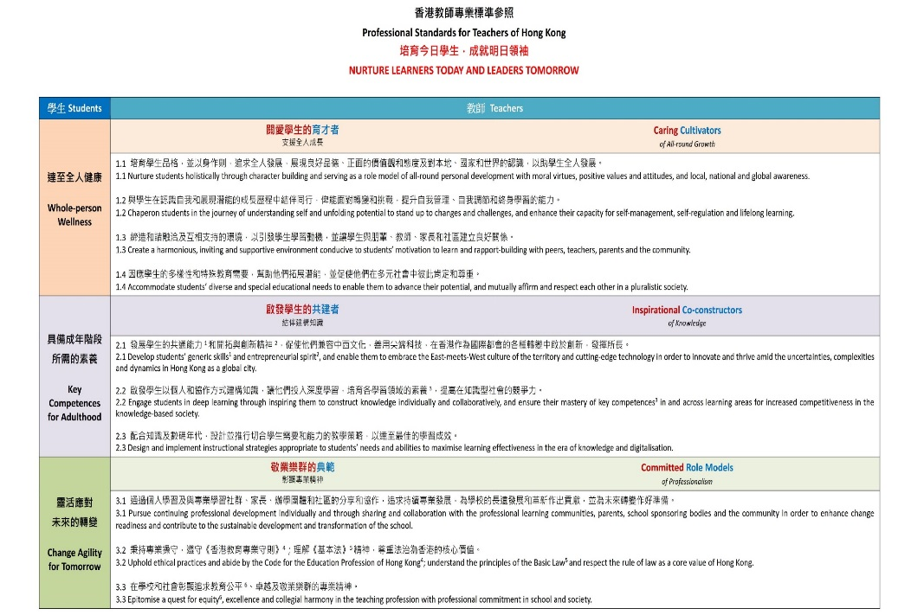
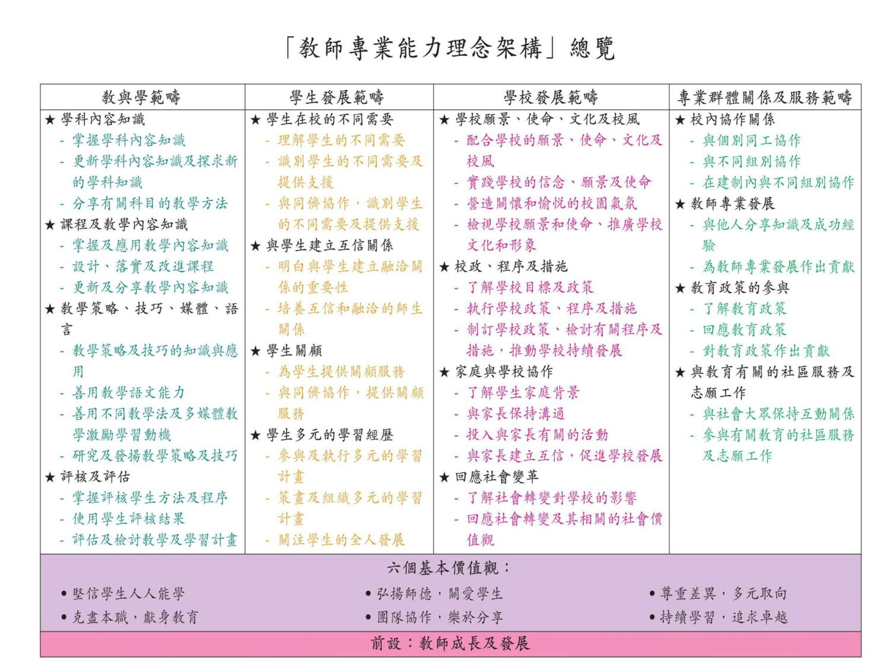
social expectation of teachers
社會對教師專業的期望(COTAP)
教師的角色 (Role)
教師的能力 (Ability)
Notes:
However, teacher leadership is exercised with a basis of the social expectation of teachers. In HK, the COTAP documents reflect the expectation of teachers from society. As teachers, we need to have good knowledge on students (and their families) and the current policies on supporting them. If we want to exercise our teacher leadership in this aspect, we need to have a mindset to make an influence on issues (or incidents) with our professional knowledge and skills.

Slide 8
How can teachers demonstrate leadership in working with families with diverse backgrounds?
Understand issues of families with diverse backgrounds
Equip with related professional knowledge, e.g. current policies on families related issues, communication skills
(Belief in) Being innovative to apply professional knowledge to make an influence

Slide 9
In Brief: as a leader, should be able to
Awareness
be aware of local policies and relevant moral and legal issues in supporting families with diverse backgrounds, and identify the same;
Responsive
actively respond to support family strength and solve the problems in a kindergarten setting; and
Reflection
reflect on the contemporary leadership role of teachers of the above response.

